Slide 1
Recap and Look Ahead
Clayton Dube 杜克雷
USC U.S.-China Institute 南加州大学美中学院
cdube@usc.edu @claydube web: china.usc.edu

Slide 2
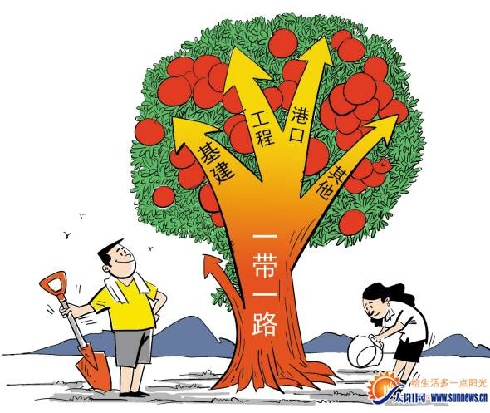

Slide 3
slogans, but also
economic imperative
domestic political imperative
geopolitical imperative

Slide 4
China’s Changing Population
MUCH slower population growth
1991-2000 ave. annual increase 1.07% 2000-2010 0.57%
2011-2016 0.45%
FEWER young people
1990 29% 14 and under 2000 23% 2010 17% 2016 17%
MORE older people
1990 5.6% 65 and older 2000 7% 2010 8.9%
2016 10.3%

Slide 5
China National Bureau of Statistics China Ministry of Education
Notes:
Number of graduates has grown from 316,000 in 1984 to almost 7 million today.

Slide 7
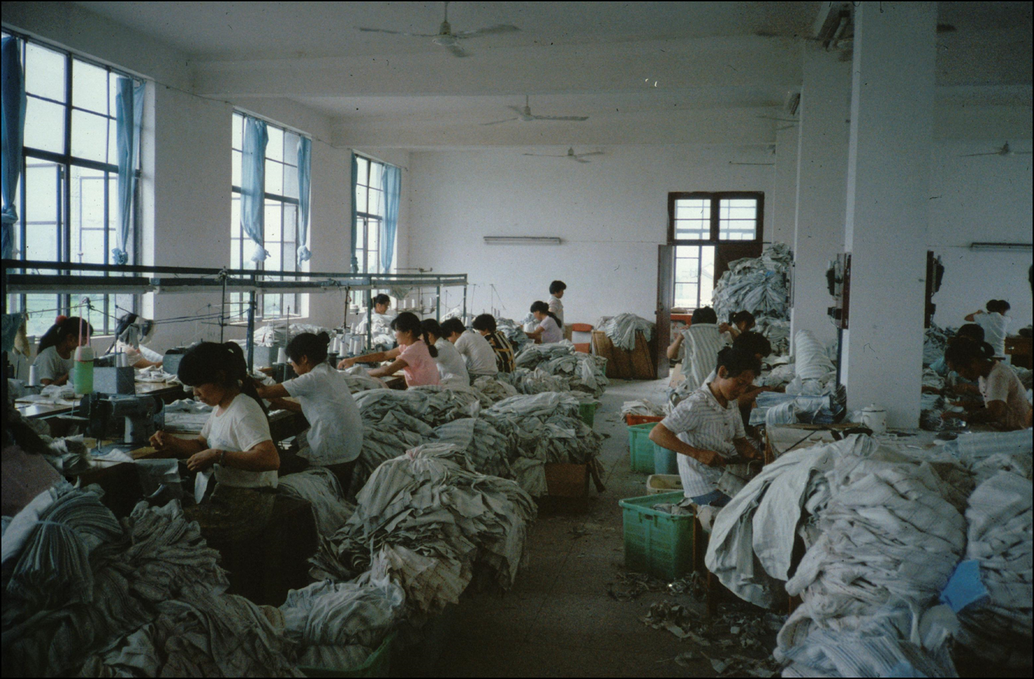
from farm to factory Loutang, Shanghai 娄塘镇， 嘉定县 (区)
Clayton Dube, 1991
Notes:
China is now the number one user of robots – example of Midea factory in Foshan, now 2 workers oversee 4 robots making remote controls, replaced 14 workers, http://english.caixin.com/2015-03-05/100788376.html

Slide 8
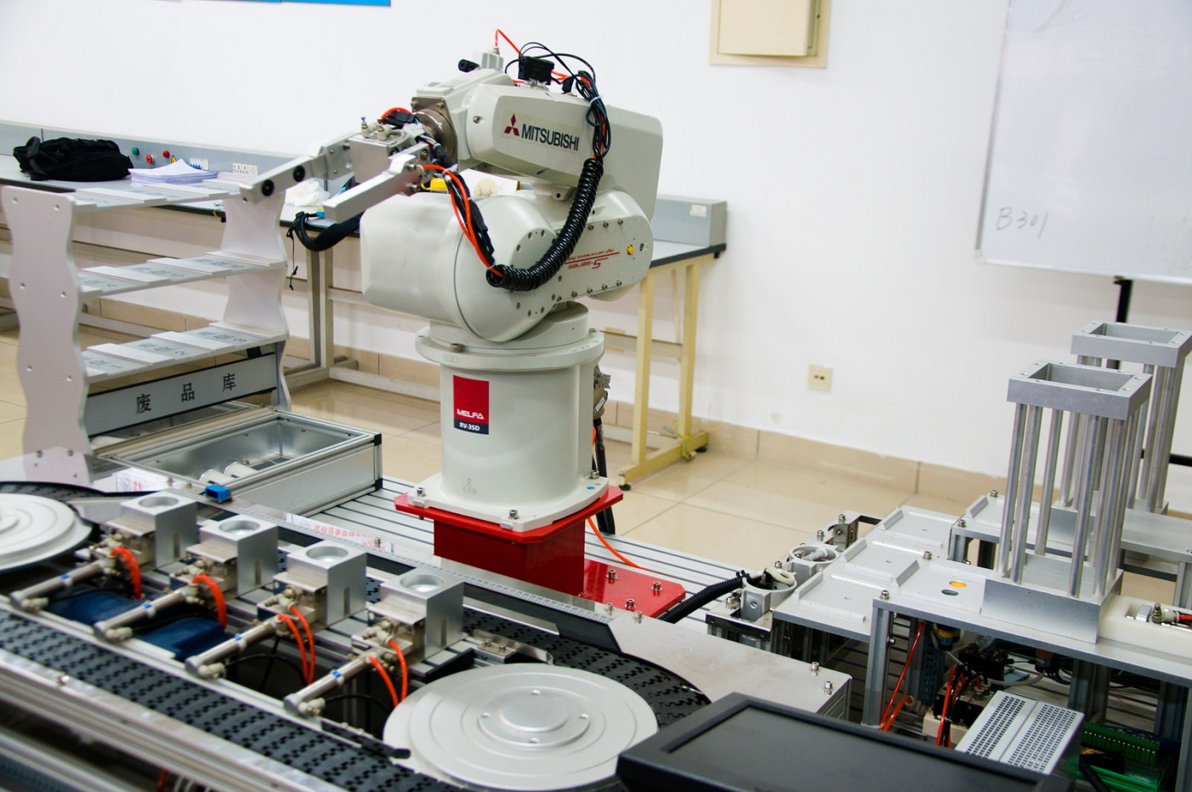
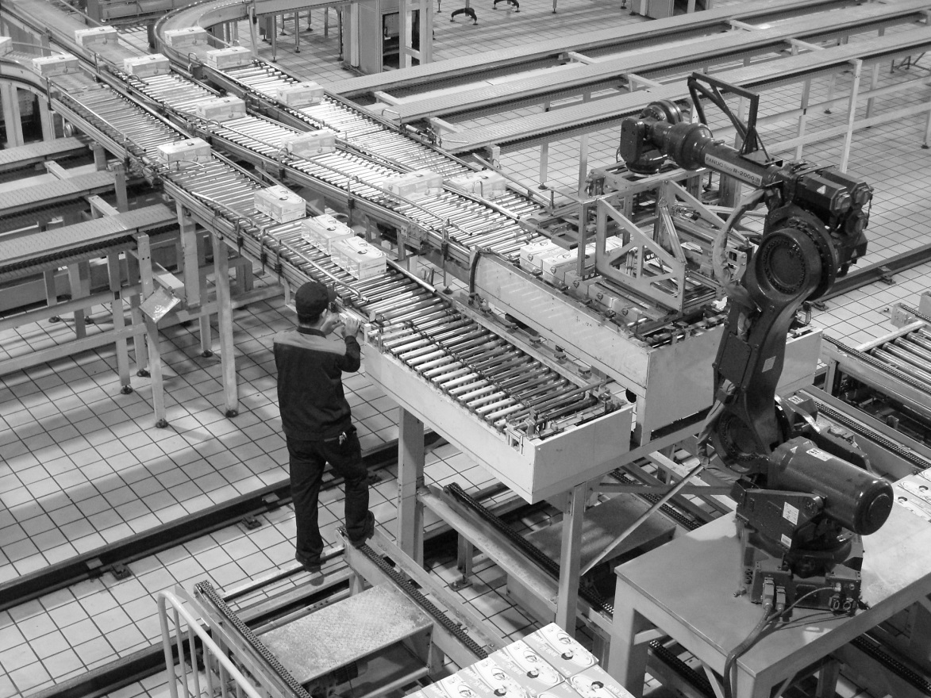
China now the largest market for industrial robots
Tianjin robot arm training Mitch Altman, 2014
Cory Grenier, 2010
Notes:
Growth just starting – China at 1/11th of the Japanese rate. China has gone from fewer than 4,000 new industrial robots in 2004 to over 27,000 new in 2013 and 32,000 new in 2014 (20% of those installed worldwide); over 200,000 in China today.
Foxconn is the heaviest user of robots, with over 10,000.
(http://english.caixin.com/2015-03-05/100788376.html); Photos via Creative Commons license

Slide 9
Innovation Productivity Consumer/Service
WeChat
NY Times
Discovery Channel -- voice messages, stickers
FinTech
payment systems competition among Chinese giants
Trade/Market Access Alibaba – MoneyGram

Slide 10
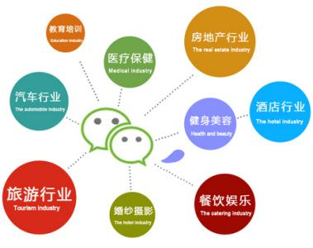
II. How does communication technology change China? (social level) A. Social changes B. Economic changes C. Educational changes D. Political changes Communication technology and innovations greatly transform China from a poor, weak, and disconnected country into an economic better off, strong and fully connected nation. At the social level, communication technology, e.g., helps Chinese people make tremendous changes in society, making it a highly connected society; helping China become the second largest economic power in the world. China’s education is making great progress and political changes are also highly observable (major problems remain).
QINGWEN DONG

Slide 11
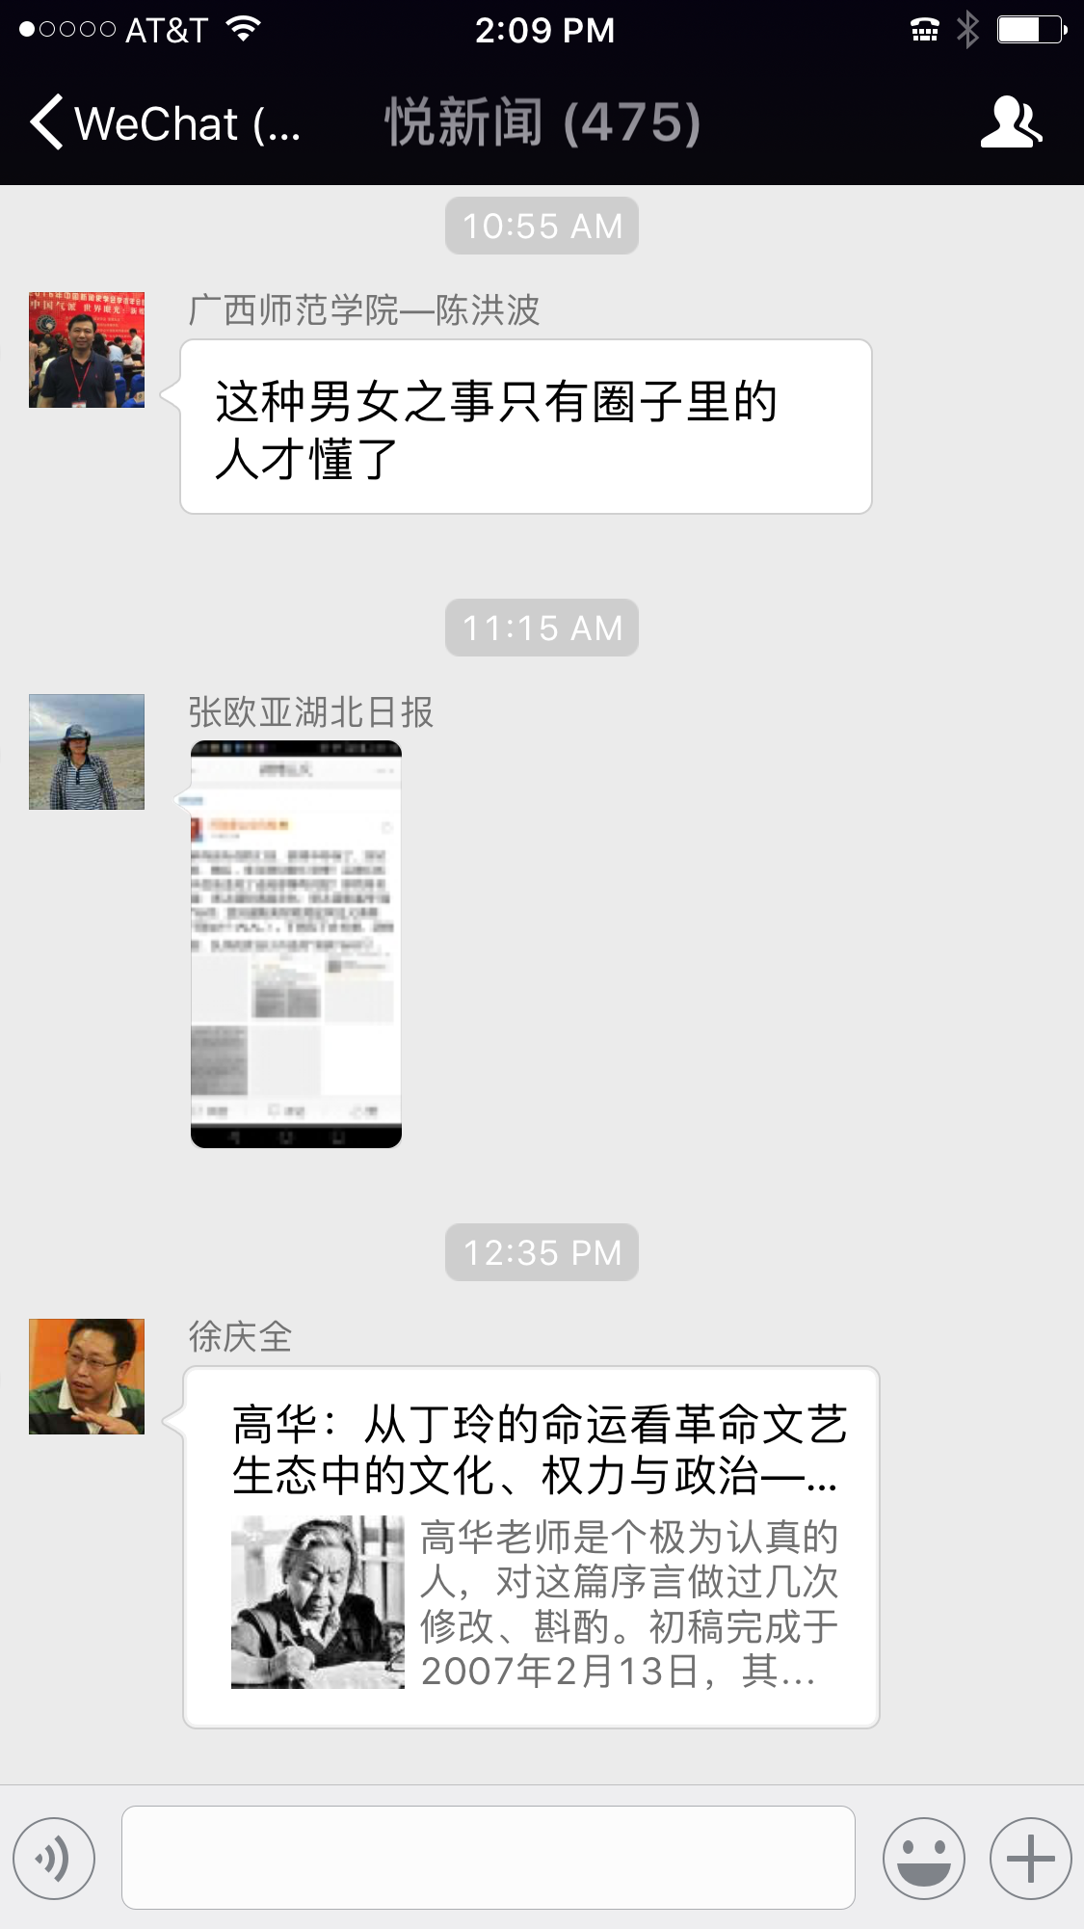
A. Social changes Communication technology greatly helps people get data, information, knowledge and wisdom A scholar described how people are involved with WeChat: “At every point of your daily contact with the world, from morning until night.” Impacts on social changes: 1. A highly frequent social interaction; 2. More people are connected through a mobile device ; 3. People tend to be socialized by opinion leaders; 4. High explosion of information challenges media users reducing the differences between urban and rural areas; 5) Empowering minority like women, young and ethnic groups of people
QINGWEN DONG

Slide 12
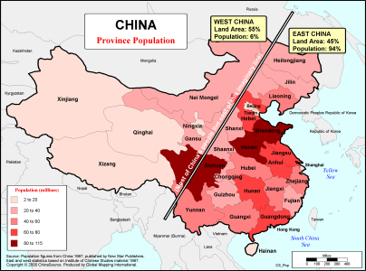
Contemporary China East 45% of the land, 94% of the people West 55% of the land, 6% of the people

Slide 13
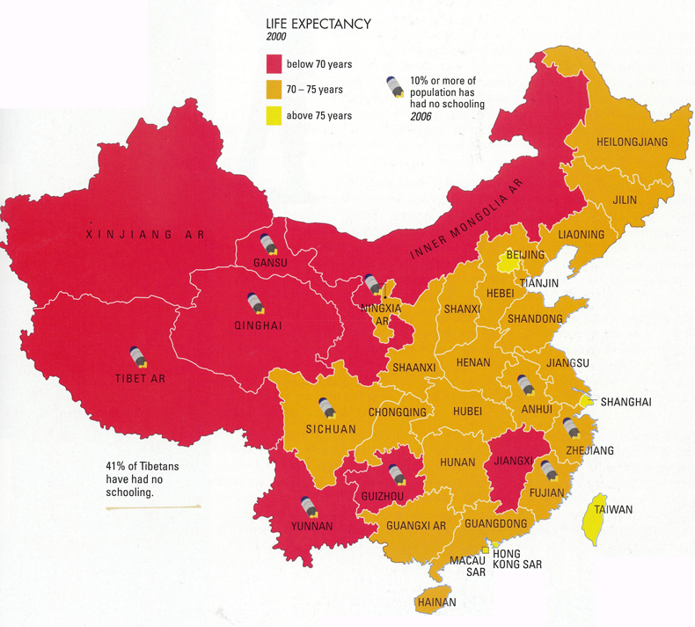
Notes:
Source: Benewick and Donald, The State of China Atlas, 2009.

Slide 14
NASA

Slide 15
Phases in China-Silicon Valley Relationship
MATT SHEEHAN
Dependence
(1994– 2001)
Competition
(2002-2015)
Segmentation
&
Synergy
(2016-Present)

Slide 16
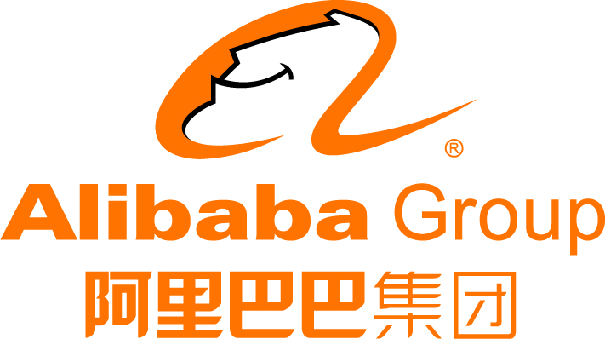
Competition (2001-2015)
MATT SHEEHAN
vs.
vs.

Slide 17
Crocodile in the Yangtze Porter Erisman, 2012
Notes:
Tencent bought Riot Games, employs more than 1,000, bought majority share in 2011 ($400m); remaining share in 2015; also big investor in Activision Blizzard and Epic Games.
Ingram Micro – 650 employed in Riverside, 980 in December. http://www.ocregister.com/2017/05/21/from-box-mover-to-software-maker-ingram-micro-thrives-under-new-owners/ $6 b purchase by HNA
AppLovin purchased by Orient Hontai Capital for $1.42 b in 2016 http://fortune.com/2016/09/26/applovin-orient-hontai-capital/

Slide 18
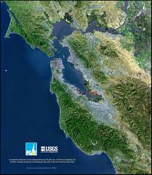
The New Paradigm
MATT SHEEHAN
People
Money
Ideas
Companies

Slide 19
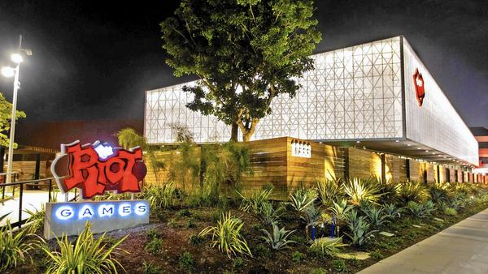
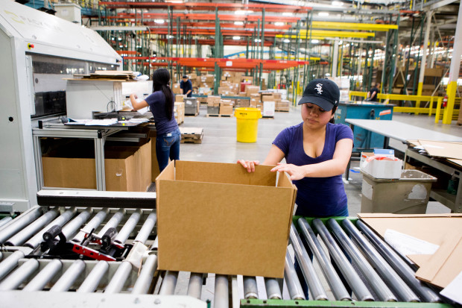
2011/2015
California jobs in 585 Chinese-owned firms:
18,300
2016
2016
Riot Games OC Register, May 2017 AppLovin Rhodium Group, 2017
Notes:
Tencent bought Riot Games, employs more than 1,000, bought majority share in 2011 ($400m); remaining share in 2015; also big investor in Activision Blizzard and Epic Games.
Ingram Micro – 650 employed in Riverside, 980 in December. http://www.ocregister.com/2017/05/21/from-box-mover-to-software-maker-ingram-micro-thrives-under-new-owners/ $6 b purchase by HNA
AppLovin purchased by Orient Hontai Capital for $1.42 b in 2016 http://fortune.com/2016/09/26/applovin-orient-hontai-capital/

Slide 20
Committee on Foreign Investment in the US (CFIUS) 美国外资投资委员会

Slide 21
China Owns US Rick Berman

Slide 22
Pew Research Center, 2016

